Slide 1

VEHICLE USER AUTHENTICATION USING OPENCV
A Major Project Report
Submitted in Partial fulfillment for the award of
Bachelor of Technology in Computer Science & Engineering
Under the supervision of
  Prof. Nidhi Singh
Assistant Professor CSE Dept.
0103CS171072
0103CS171006
0103CS171091
0103CS171046
Krishna Yadav
Abhishek Jain
Ojasva Saxena
Bhola Prasad Chilhate

Slide 2
Contents
Introduction
Problem Statement
Major objective & scope of project
Software/Hardware Requirement
Proposed Method
Project limitation and Future scope
References

Slide 3
Introduction
This research project uses the help of new modern breakthroughs in AI and ML to implement better solution to authenticate a user before riding a vehicle.
This project aims at developing a solution to authenticate or verify a user before using a vehicle.
The system would ask for user's driver's license to get details about the person, then it would also take video feed from the camera installed in front of driver's seat to verify the person, and finally decide whether to give access to the vehicle's controls or not.
The driver and his original driver's license are a must for this authentication system.
The working of the system would be displayed by developing an interactive and simplistic website, which would be using general directory system for storing user's data temporarily.
This website would be using OpenCV library for making rapid ML model to verify the identity of a user.
This project would be designed by using languages such as Python, HTML, CSS and JavaScript.

Slide 4
Problem Statement
The problem domain for this project is related to Road Safety and Security.
This project uses the ongoing modern technologies and tools into practice to develop a useful software or website for general public to embed in a vehicle for safety and security.
We see nowadays that some people illegally driving various vehicles, without owning a specific driver’s license for themselves.
This system will be helpful for general public by implementing an interface to verify the driver before giving him access to a vehicle. This system would give access to the drivers owning a verified driver’s license.
We will be developing a website for accepting driver’s license and video feed containing the driver’s face for verification. The website is expected to be interactive and simplistic.
The verification system will be developed by the use of specific machine learning algorithm by referring the OpenCV library.

Slide 5
Major objective of project
Following are the major objectives of our project:
Gathering all the information and the tools necessary for building this project.
Designing a meaningful and simplistic website for efficient usage of the system.
To design fairly accurate user verification system using OpenCV tools.
Writing an optimized and robust code for the website design and the internal program.
To develop our website and its processes as fast, efficient and robust as possible.
Integrating the website and the internal program.
Performing thorough testing of the project.

Slide 6
Scope of project
We will build our machine learning model using python because it is very interactive and easy to code in case of developing ML models. For the major part we will be using OpenCV library and its tools for training our ML model. There are other various libraries available in python such as pickles, numpy, pandas, scipy, scikitlearn, etc. which are a great help in machine learning.
Also, we will be using HTML, CSS, and various technologies and some python scripts and libraries such as Flask to develop website and deploy our ML model to website.
Due to hardware limitations for building ML model, we will be using a relatively small dataset for our model which might not work much efficiently (due to small training set). Apart from hardware limitations, ML models never works fully perfect in every scenario, rather it may improve overtime.
For most of the time, OpenCV Machine Learning algorithms gives out fairly accurate predictions.

Slide 7
Software/Hardware Requirement
Hardware Platform Environment
A working PC or Laptop.
A working Webcam.
Processor: Any (Intel, AMD, etc.)
GPU: Any (Nvidia, AMD, Intel, etc.)
Memory: min. 1 GB RAM (2 GB recommended).
Working internet connection (Recommended).
Software Platform Environment
Operating System: Any Latest (Windows, Linux, etc.)
Any latest Browser with JavaScript enabled. (Chrome, Firefox, etc.)
Scripting languages such as HTML, CSS, Python 3, etc.
Latest Python setup used with certain libraries installed.
Libraries such as numpy, cv2(OpenCV), pickles, etc.
Website development environment such as Notepad++ and Google Chrome.
Development environment such as Anaconda and python 3.
Web server deployment software (Apache, WAMP, XAMPP, etc.)

Slide 8
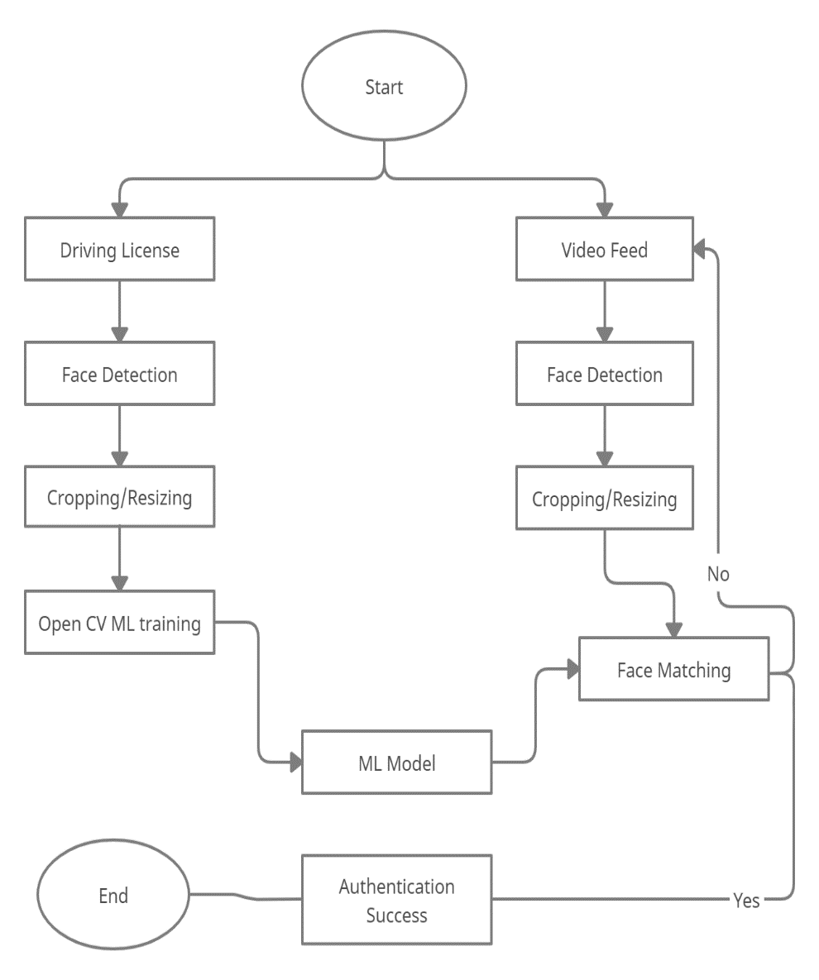
Proposed Method
Fig 5.1 shows the DFD for this project and Fig 5.2 shows the Use-Case diagram for the Project.
Fig 5.1 shows the Data Flow Diagram in which mainly two inputs, license image and video feed are taken from user and further processing on the images such as face detection, cropping and resizing of images are performed in real-time. Then the processed images are taken for Model training and face matching, and the process repeats for a certain limit, if face does not match. Otherwise, if match is found, access is granted to the user and the process ends. If match is not found after enough iterations, user is denied to access the vehicle.
Fig 5.1 Data Flow Diagram of the project
Fig 5.1 shows the Data Flow Diagram in which mainly two inputs, license image and video feed are taken from user and further processing on the images such as face detection, cropping and resizing of images are performed in real-time. Then the processed images are taken for Model training and face matching, and the process repeats for a certain limit, if face does not match. Otherwise, if match is found, access is granted to the user and the process ends. If match is not found after enough iterations, user is denied to access the vehicle.

Slide 9
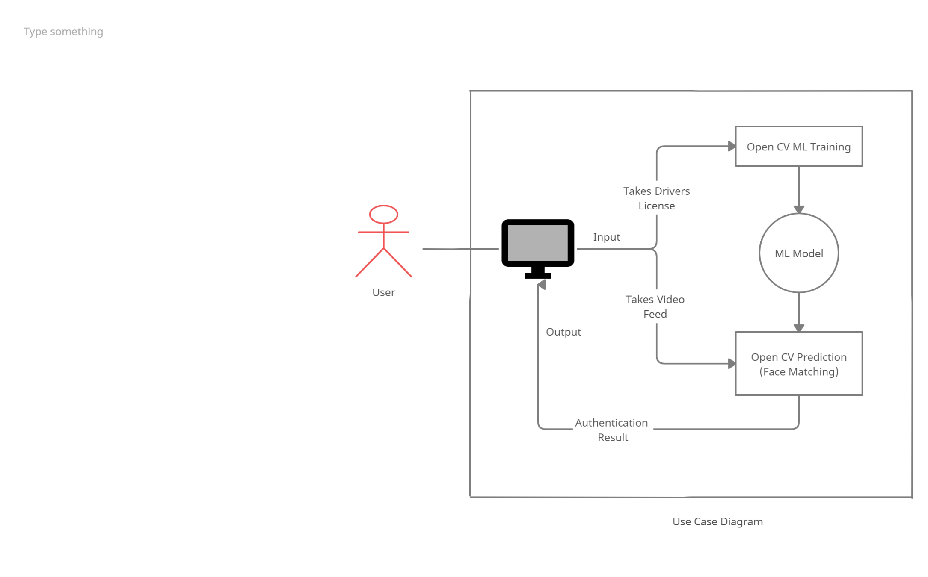
Proposed Method
Fig 5.2 shows the use-case diagram of the project, in which the user is asked his driving license first which is processed to train a model by using OpenCV library. Then the user is asked to provide his real-time video feed, which is processed by the machine and is further matched against the trained ML model. Using the results, the program decides whether to authenticate the user or not and displays out the result on the website for the user to see.

Slide 10
Project Limitation
This project might have following limitations:
This project only provide solution through website and it does not provide any application for the user. So, it is limited to websites only for now.
Face detection can be fooled by showing a photograph or similar faces.
The dataset used in developing the model is relatively small which might affect the accuracy of the prediction of our project.
Due to hardware limitations of the developing environment, the ML model is less reliable and less accurate.
In practice, ML model are never said to be always accurate in predicting as compared to actual human being’s prediction.

Slide 11
Future Scope
Following key points can add up to the future scope of the project:
We might embed our solution to Arduino or Raspberry Pi, so that we can test our system on actual vehicles or a simulated environment.
We might also validate driver’s license using online government servers for better security.
We might also add a functionality to allow only certain person to use vehicle, even if they have valid license, so that we can reduce Vehicle Theft.
We can improve our ML model’s accuracy by increasing development environment capabilities.

Slide 12
References
https://docs.opencv.org/
https://github.com/maddevsio/go-idmatch
https://github.com/CatalystCode/faceanalysis
https://github.com/domjhill/Python-FaceTemplateMatching
https://www.youtube.com/PmZ29Vta7Vc
https://www.google.com/
Websites like www.javatpoint.com, www.geeksforgeeks.com, etc

Slide 13




